Slide 1
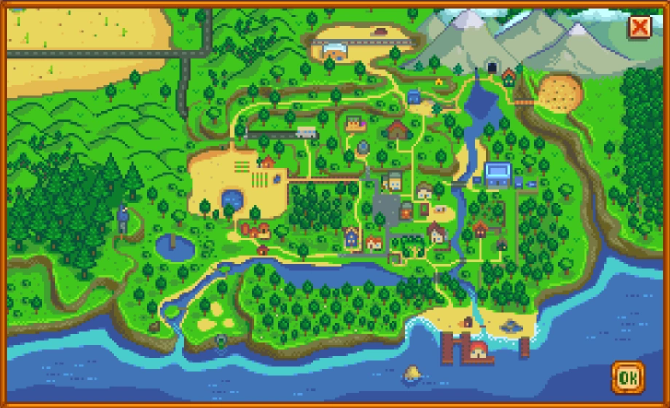
Mines
Mountains
Start Here
Your_Farm
Carpenter
Community_Center
Wizard_Tower
Marnie_Ranch
Bus_Stop
Village
Museum
River
Beach
Ocean

